Slide 1

The Internet
Introduction to Networking
(Condensed Version)

Slide 2

Local Area Network(LAN)
local area network(LAN): a group of interconnected computers that share resources in a small geographic area.
A host is a computer on a network.
Notes:
Computing device
host

Slide 3

Server-Client
Notes:
A computing system is a group of computing devices and programs working together for a common purpose. A computer network is a type of computing system.
A path between two computing devices on a computer network (a sender and a receiver) is a sequence of directly connected computing devices that begins at the sender and ends at the receiver.
A client is a computer that is requesting a resource or service.
A server is a computer that provides a resource or service.
Print servers provides printing service, web servers serves webpages, email servers, file servers, etc…

Slide 4
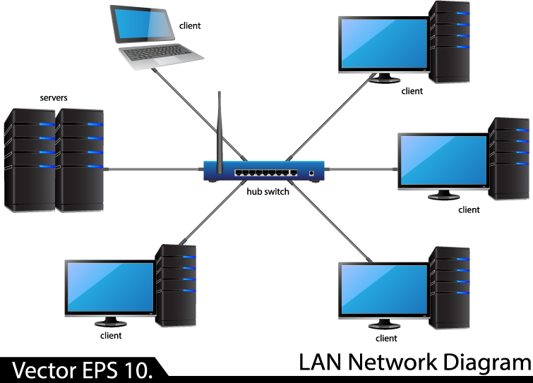
Switches
Switches allow computers on a LAN to communicate with one another.
Notes:
A MAC address is a physical, hardware address on a Network Interface Card(NIC).

Slide 5
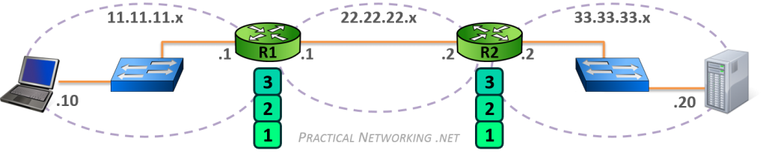
Switch vs. Router
Notes:
The Internet Protocol(IP) address provide worldwide addressing that identifies the computer’s local network.

Slide 6
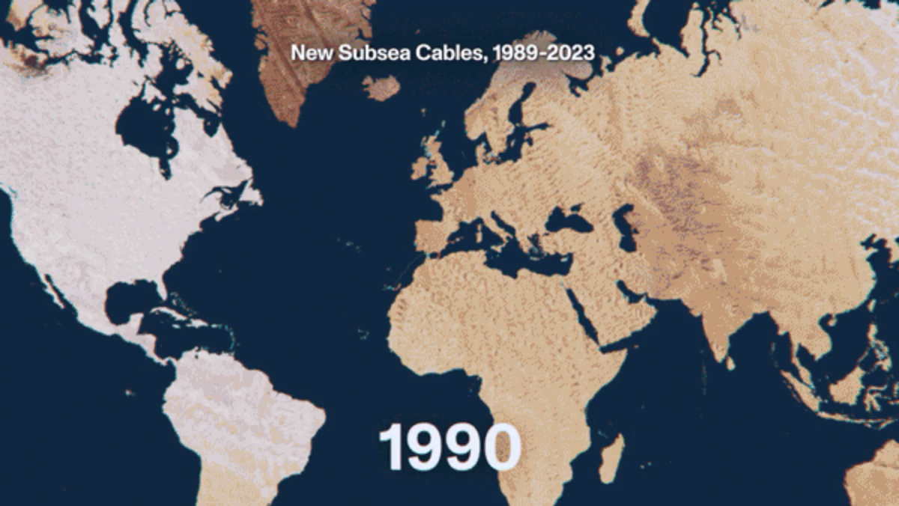
Communicating Across Oceans

Slide 7
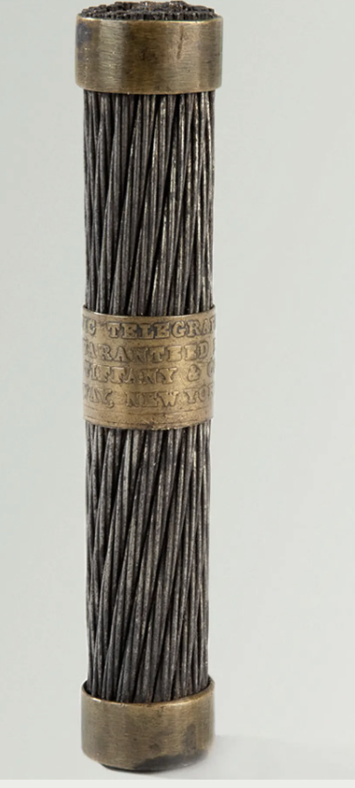

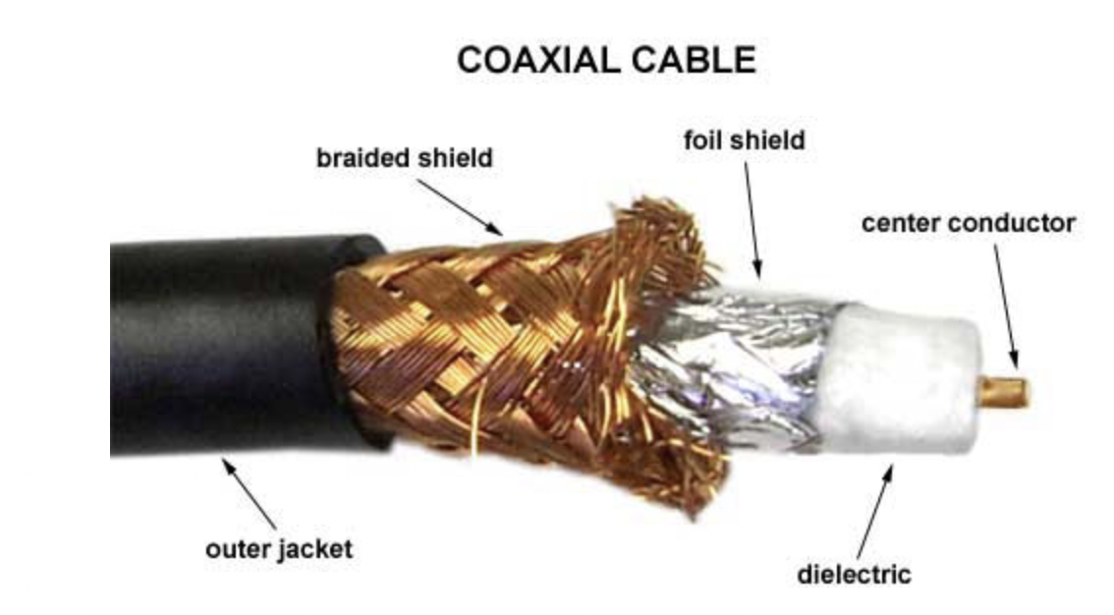
Telegraph cable
coaxial cable
Fiber optics

Slide 8
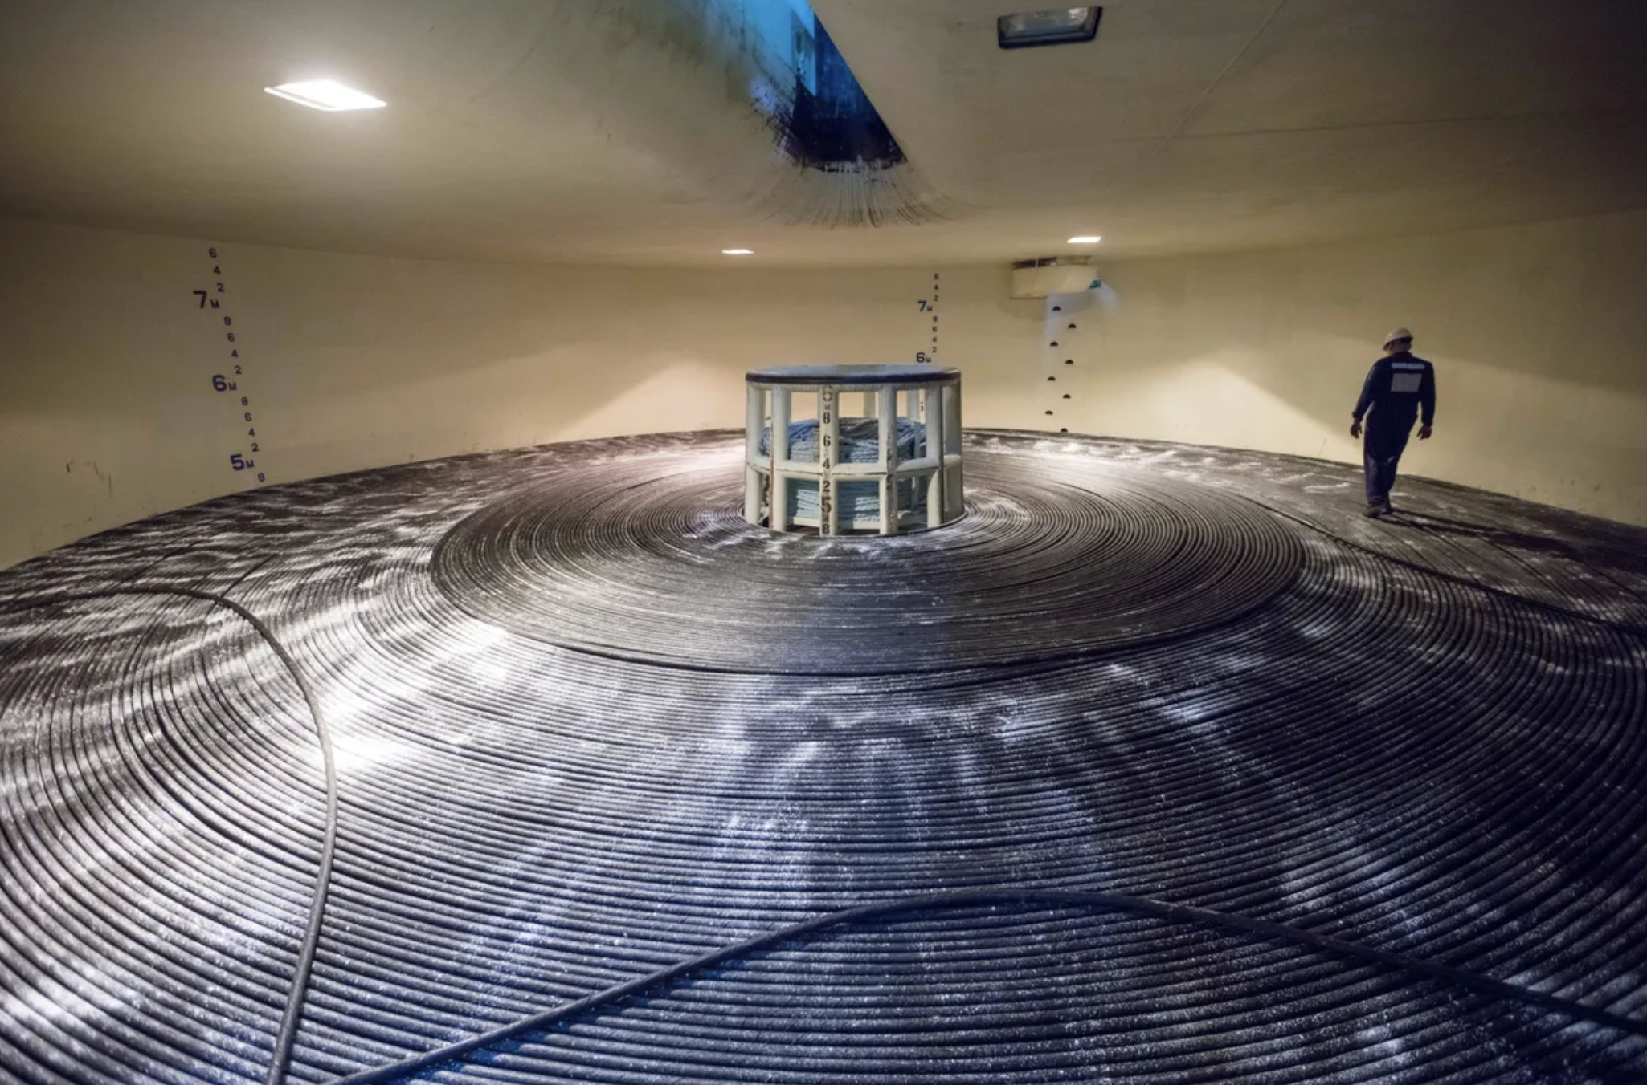
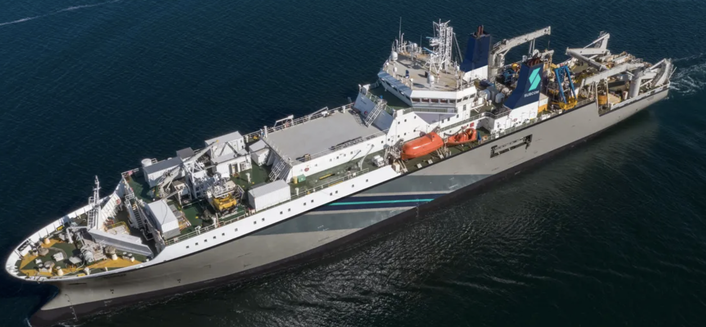

Slide 9
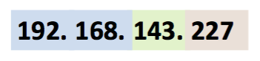
IP Address(IPv4)
Notes:
The IP address is a unique 32-bit that identifies on which network the computer is located as well as differentiates the computer from all other devices on the same network.

Slide 10
Private IP Addresses
The three address blocks for private IP addresses are:
10.0.0.0 – 10.255.255.255
172.16.0.0 – 172.31.255.255
192.168.0.0 – 192.168.255.255
Notes:
In a small LAN, computers/hosts are assigned private IP addresses that can identified them locally.
These private IP addresses are not unique; two hosts from two different LAN can have the same private IP address.
When a computer make a request for a resource outside of its LAN, e.g. CNN’s webpage, the request passes through the router that is responsible for data packets leaving/entering the network.
This router is known as the default gateway.
The Internet Service Provider(ISP) assigns one public IP address to the entire network. Any outside traffic to and from computers inside the network is routed to this public IP address.

Slide 11
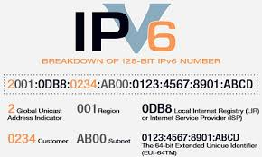
IP Address(IPv6)
Notes:
For IPv6 uses 128-bits for a total of approximately 3.4x10^{38} addresses.
The address is divided into eight 16-bit parts. The format is 8 groups of four hexadecimal digits.

Slide 12
Network Applications
A network protocol is a set of rules for how applications intercommunicate.
Common protocols/applications include:
Simple Mail Transfer Protocol(SMTP)
Hypertext Transfer Protocol(HTTP) for sending/receiving webpages
HTTPS(HTTP Secure)
Transmission Control Protocol(TCP) is the protocol that is responsible for sending data packets across the internet btween computers.
TCP/IP: A TCP packet is sent using IP addresses, hence the term TCP/IP.
Notes:
Communication between connections on the Internet are governed by rules known as protocols. A protocol is an agreed-upon set of rules that specify the behavior of a system.
A network application lets a computer interact with other computers by performing a specific set of tasks.
Browsers, email clients, etc…
TCP is a host-to-host protocol that provides reliable, connection-oriented communication over IP networks between two endpoints.
reliable: data received is intact, error-free and assembled in the correct order. Any lost data is retransmitted.
Connection-oriented: Using a system of acknowledgements called the Three-Way-Handshake, two computers confirm the connection before data transmission.

Slide 13
Packets
Packets
Data and metadata
Packet-switching system
Routing
Dynamic
Redundant
Fault-tolerant
Latency(seconds) vs bandwidth(bits per seconds)
Notes:
The Internet transmits data streams from one computer to another by breaking the data down into small manageable units that are known as packets. This system is called a packet-switching system.
A packet is defined as a small chunk of digital data that contains both a sender address and an address to where the packet is supposed to go.
A single image could contain anywhere from just a handful of packets to upwards of 10,000 depending on a variety of factors.
The process of determining where packets go is called routing or selecting a path for traffic in a network.

Slide 14
Name Resolution
Domain Names: structured, user friendly system names provided by TCP/IP. Examples of top-level domain names:
.com, .org, .edu, .gov, etc…
Name Resolution: the process of mapping logical addresses back and forth into domain names
172.217.204.102 is mapped to www.google.com
DNS(Domain Name Service)

Slide 15
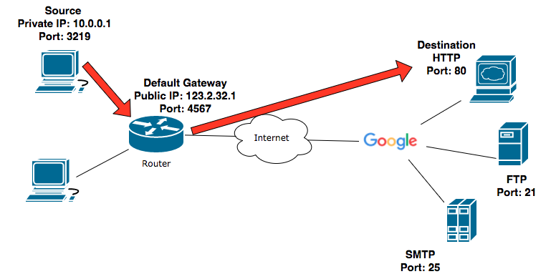
An HTTP Request(optional)
A webpage(HTTP) request from a computer.

Slide 16
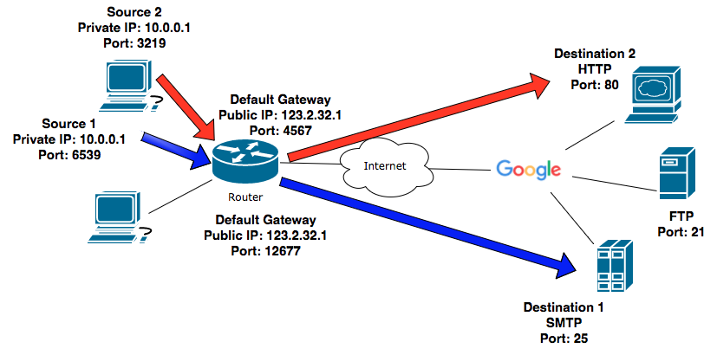
An HTTP Request(optional)
A webpage request and sending an email from the same computer.

Slide 17
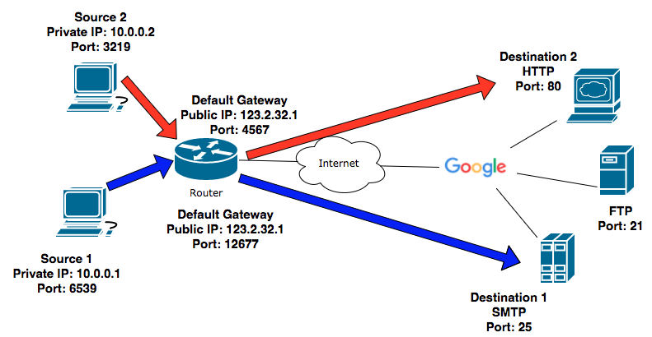
Port Numbers(optional)
Computer 1 sending an email. Computer 2 requesting a webpage. Both computers are in the same local area network.

